Slide 1
The Globalization Origins of Autocratic Rise
Engaged Reformers, Autocratic Advantages, and the Post-Cold War Reversal
George Yean
Department of Government
Harvard University
March 3, 2025

Slide 2
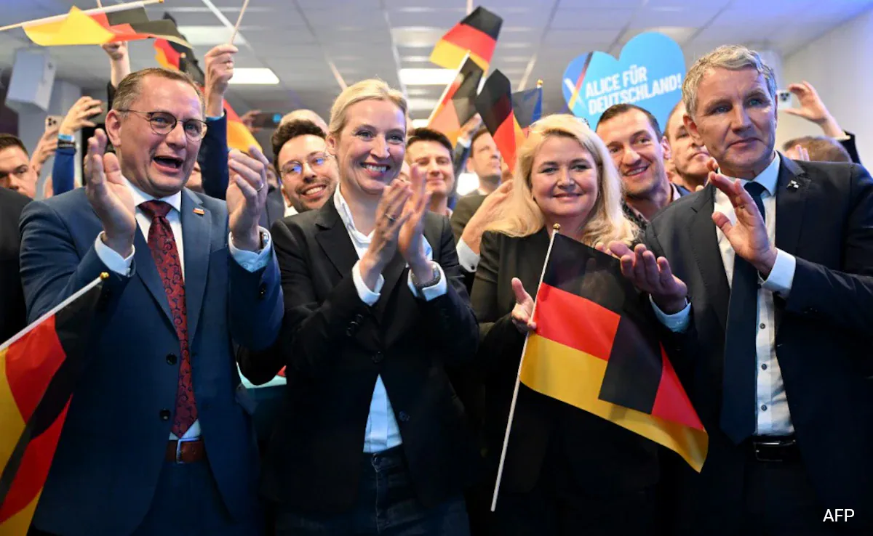
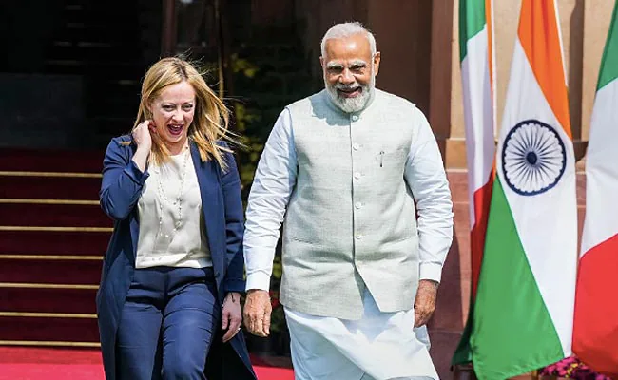
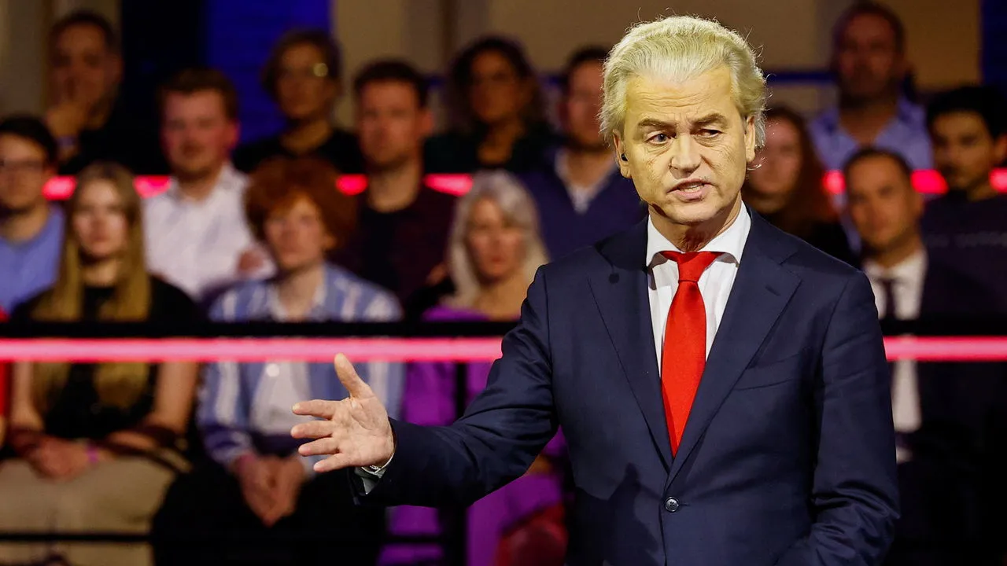
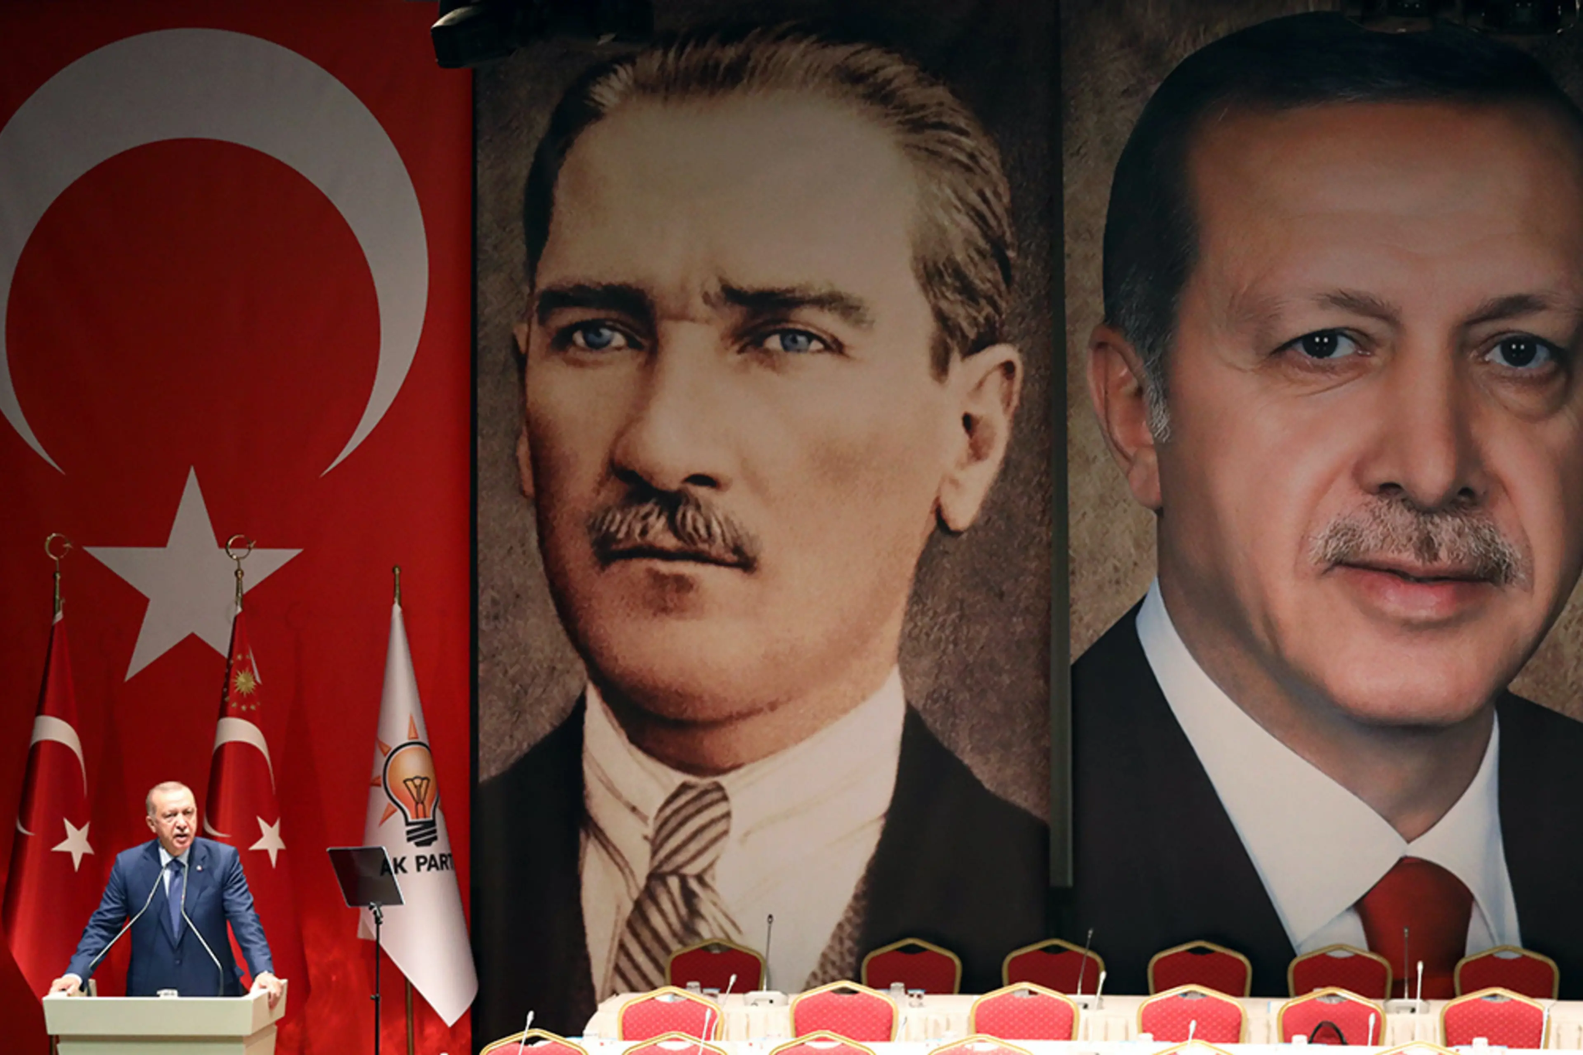
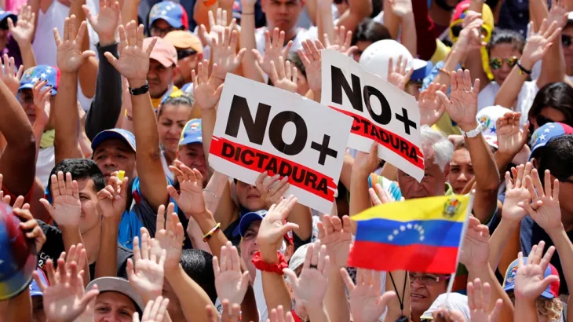

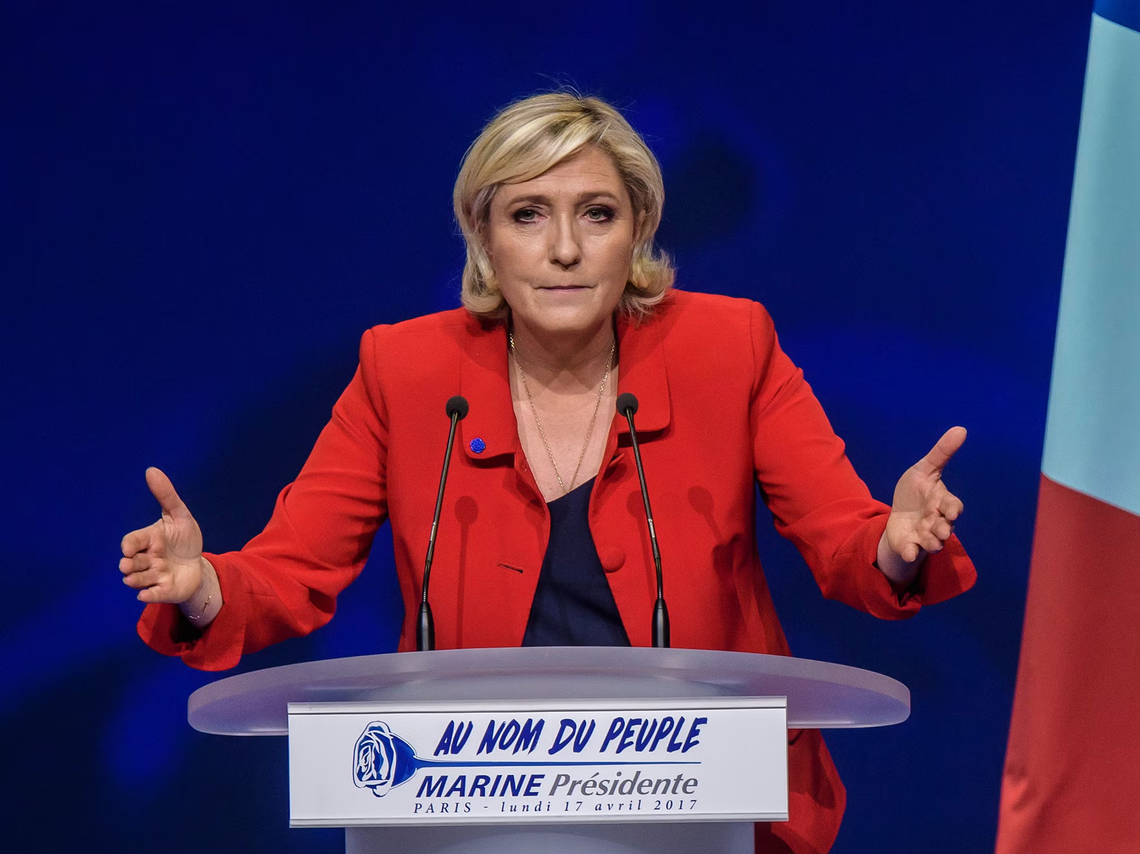
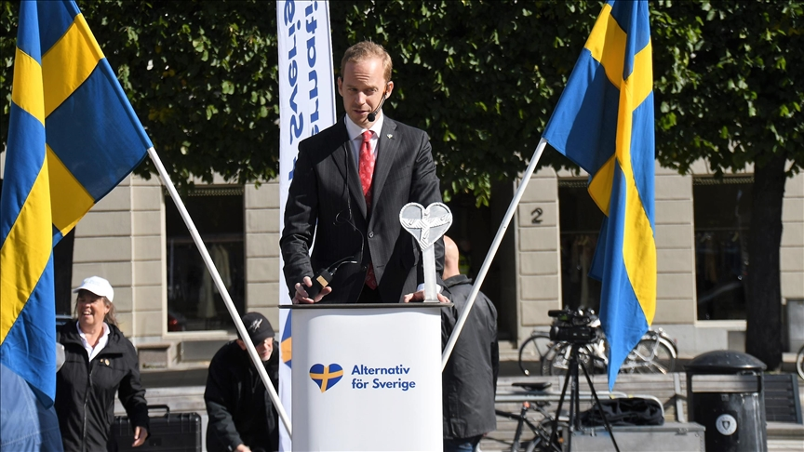

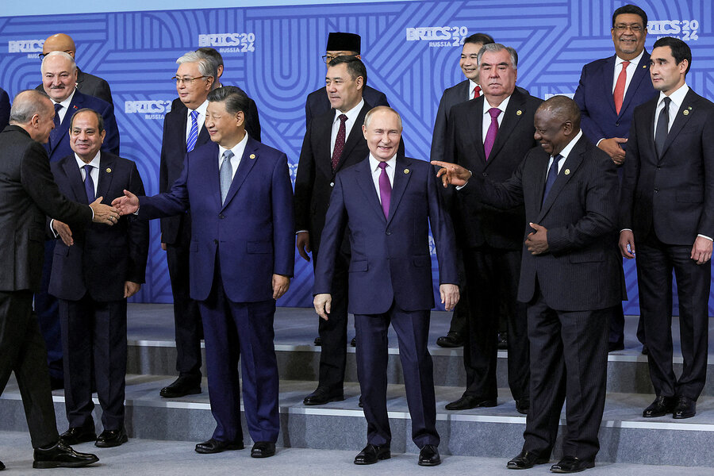
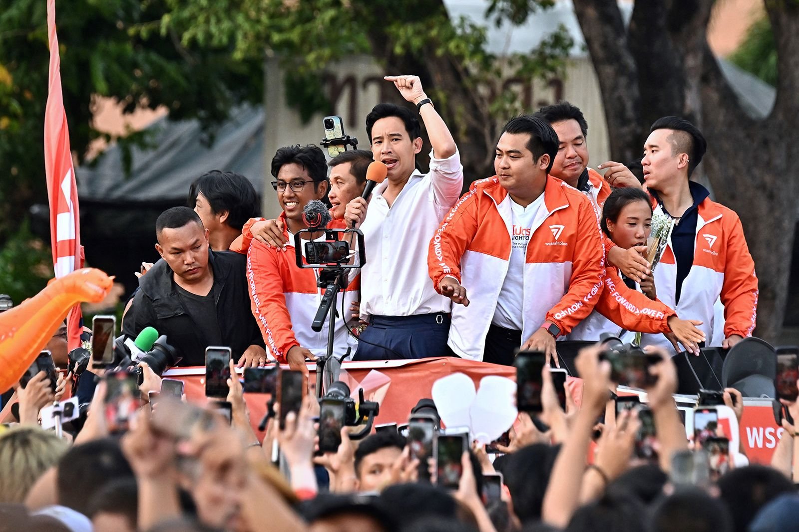
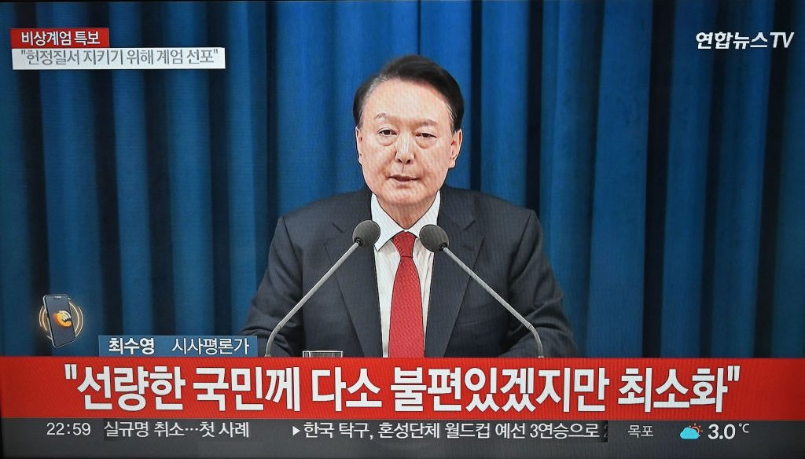
Democratic Backsliding
, or Global Democracy Crisis?
Notes:
“trade and economic endeavour should be conducted with a view to raising standards of living, ensuring full employment and a large and steadily growing volume of real income and effective demand, developing the full use of the resources of the world and expanding the production and exchange of goods.” Institutional development frequently depends on prior outcomes ("path dependence") and evolutionary forces. As institutions evolve, rational design choices can arise in two ways. First, participants may modify institutions in stages, by making purposeful decisions as new circumstances arise, by imitating features from other institutions that work well in similar settings, or by designing explicit institutions to strengthen tacit cooperation. Second, institutions may evolve as states (and other international actors) select among them over time. States favor some institutions because they are better suited to new conditions or new problems and abandon or downplay those that are not. For example, the obvious place to handle intellectual property rights would seem to be the World Intellectual Property Organization, but the countries that generate most patents chose to move the issue to the WTO because it offered better enforcement mechanisms. Thus the institutionalization of the issue evolved significantly, not because an older institution was modified, but because another one offered a better institutional design.

Slide 3
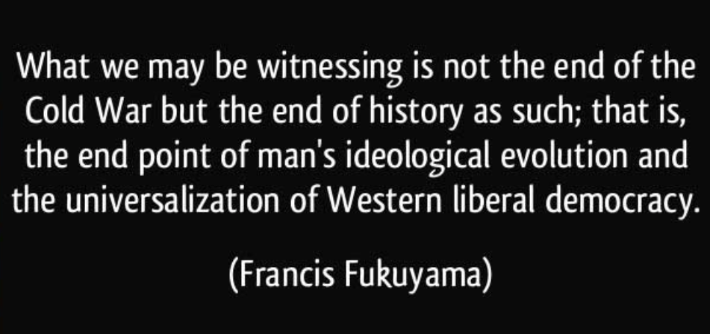
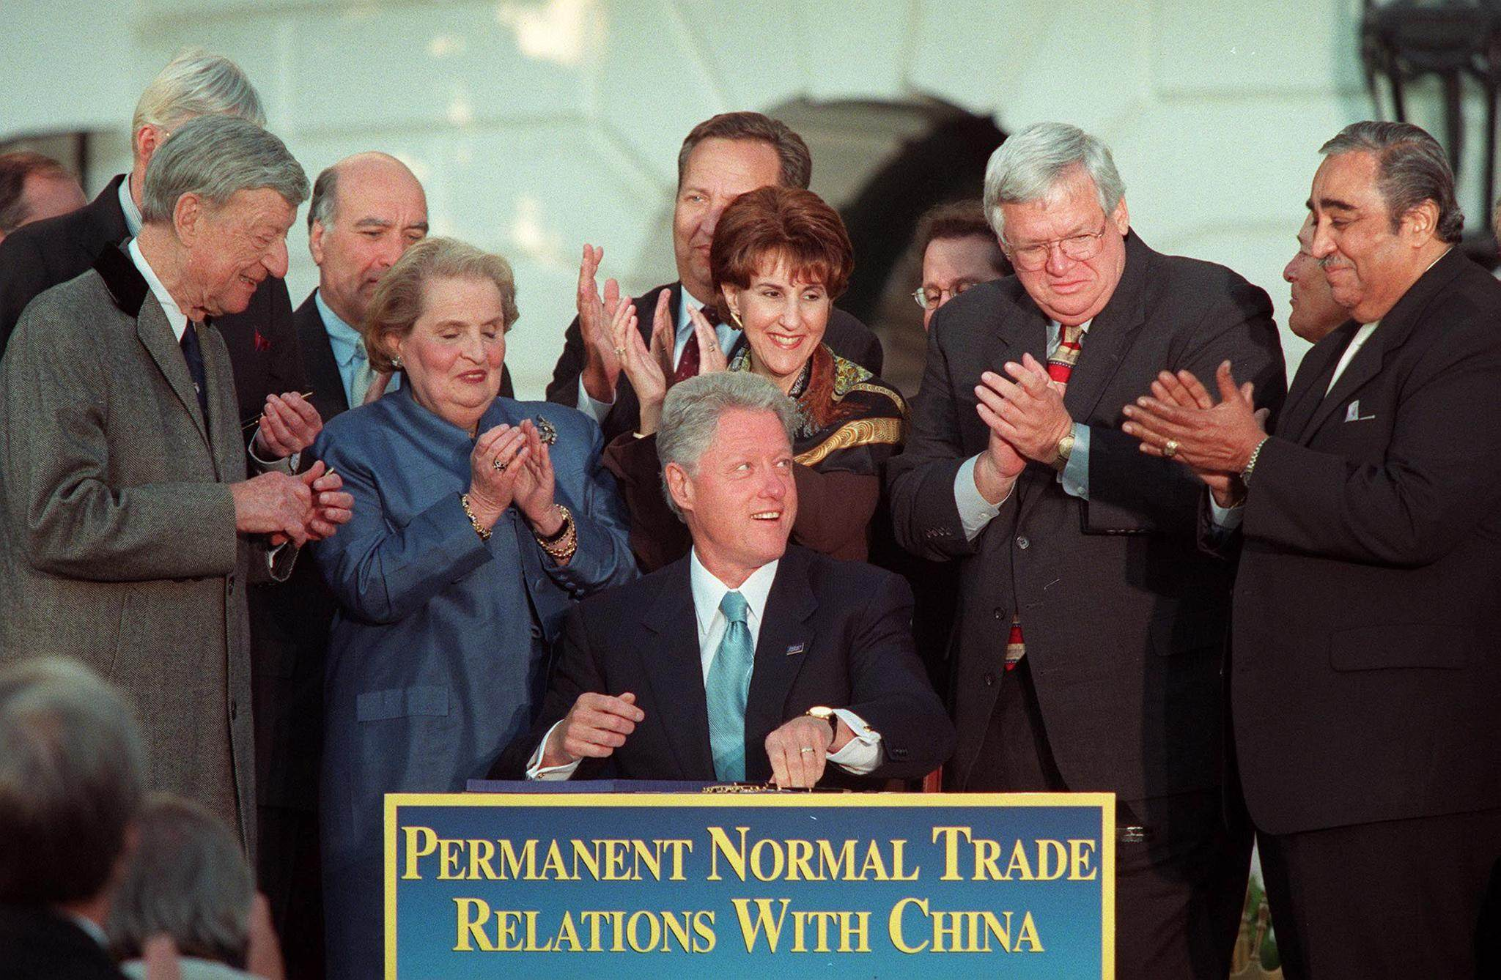
vs. 1990s Optimism
"...So if you believe in a future of greater openness and freedom for the people of China, you ought to be for this agreement."
Notes:
“trade and economic endeavour should be conducted with a view to raising standards of living, ensuring full employment and a large and steadily growing volume of real income and effective demand, developing the full use of the resources of the world and expanding the production and exchange of goods.” Institutional development frequently depends on prior outcomes ("path dependence") and evolutionary forces. As institutions evolve, rational design choices can arise in two ways. First, participants may modify institutions in stages, by making purposeful decisions as new circumstances arise, by imitating features from other institutions that work well in similar settings, or by designing explicit institutions to strengthen tacit cooperation. Second, institutions may evolve as states (and other international actors) select among them over time. States favor some institutions because they are better suited to new conditions or new problems and abandon or downplay those that are not. For example, the obvious place to handle intellectual property rights would seem to be the World Intellectual Property Organization, but the countries that generate most patents chose to move the issue to the WTO because it offered better enforcement mechanisms. Thus the institutionalization of the issue evolved significantly, not because an older institution was modified, but because another one offered a better institutional design.

Slide 4
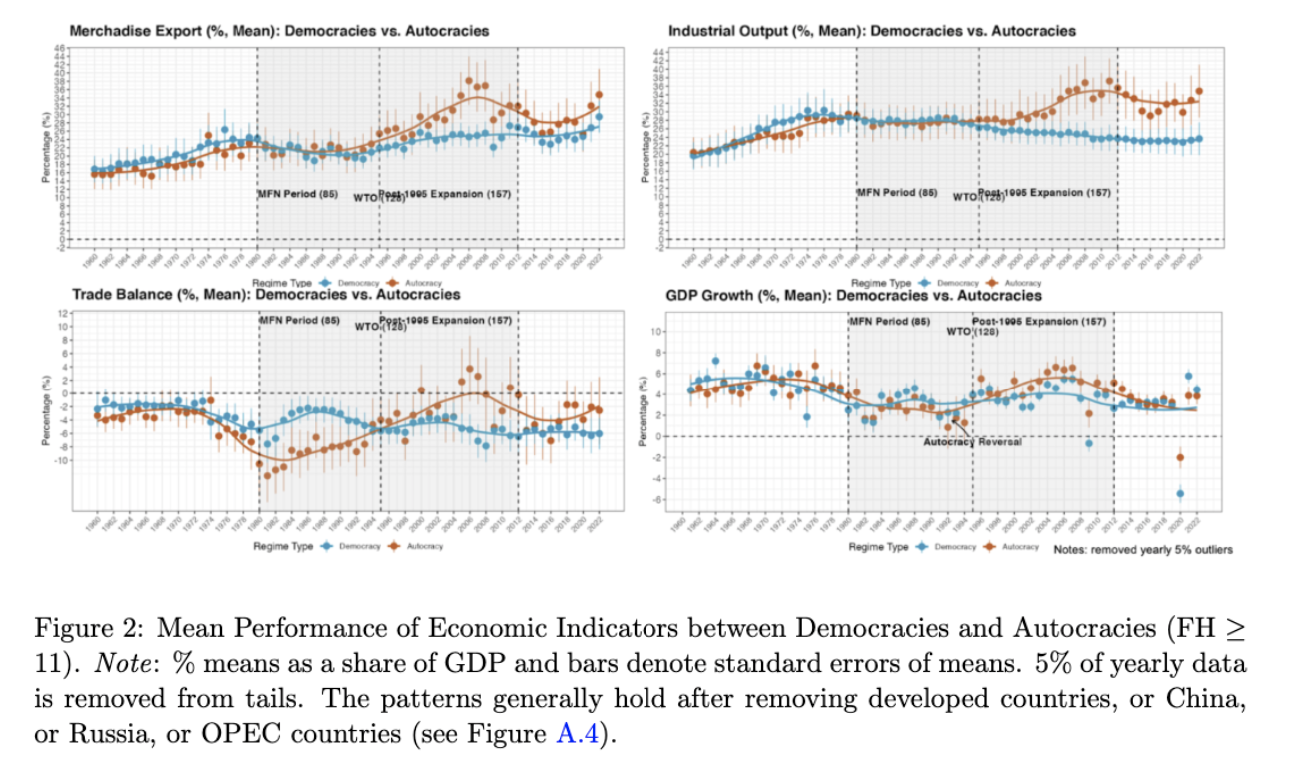
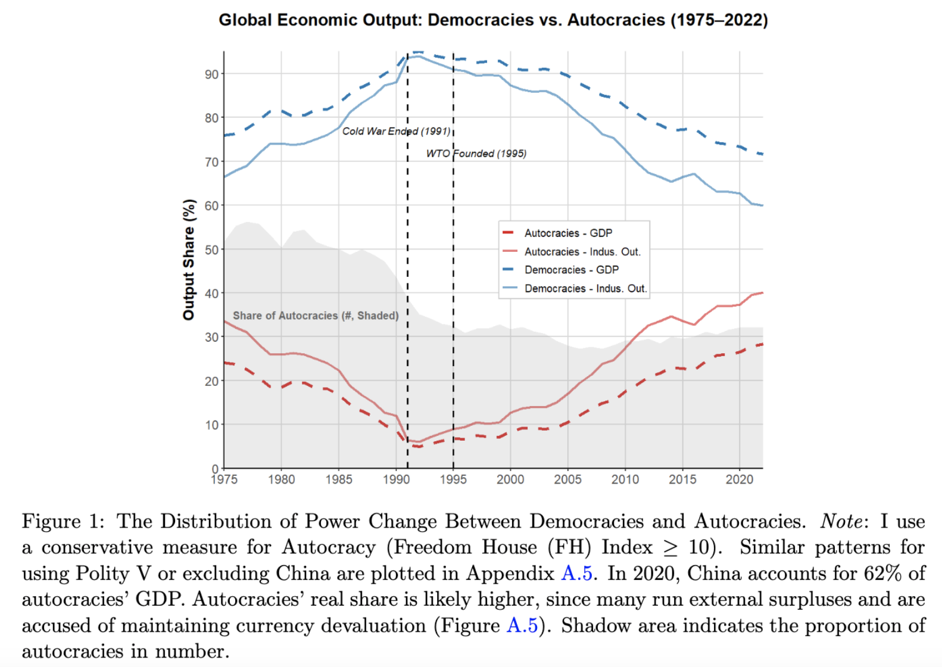
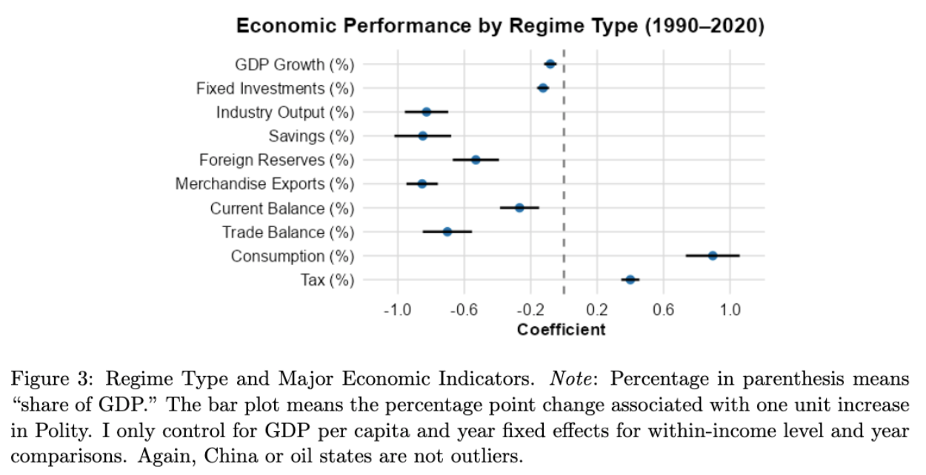

Puzzle: Autocratic Rise
Not only democratic backsliding

Slide 5

Connecting the Literature
Regime type & growth: mixed
(Przeworski et al. 2000; Barro 1996)
Regime type & exports: democracy is better (Eichengreen and Leblang 2007; Levchenko 2007; Yu 2010)
Institutionalism: inclusiveness is better
(Acemoglu et al. 2001; Acemoglu et al. 2012; North 1990)
“autocratic adv.”: strong/benevolent leaders, Autocracy 2.0
(Becker 2010; Easterly 2011; Yang 2024)
Mostly use pre-2000 data
Primarily on internal mechanisms
Ignore post-90 global transformation

Slide 6
What global transformations?

Slide 7
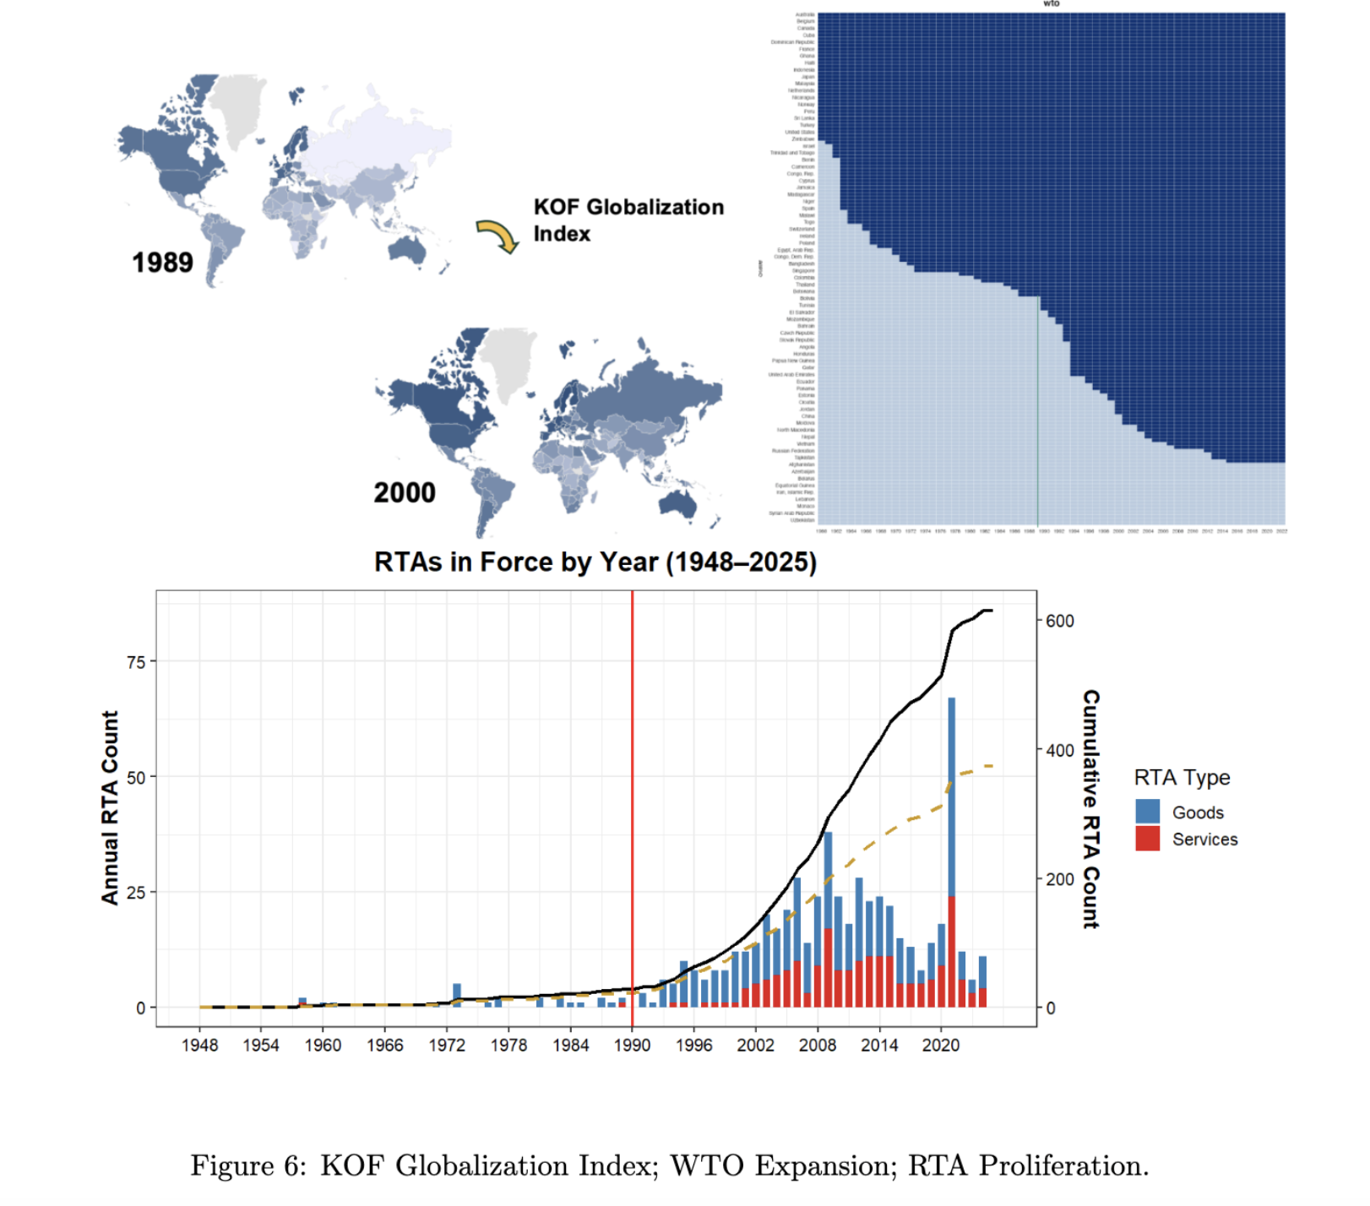
Transformation: Trade Integration
“Hyper-globalization” (Rodrik 2018)
WTO – “the most heralded commercial agreement in history” (Bagwell and Staiger 2002; Goldstein et al. 2007)
Other: MFN/PTA, RTA
IOs enhance credible commitments
“by 2000, most post-communist countries reoriented trade to Western markets” (Aslund 2012)

Slide 8
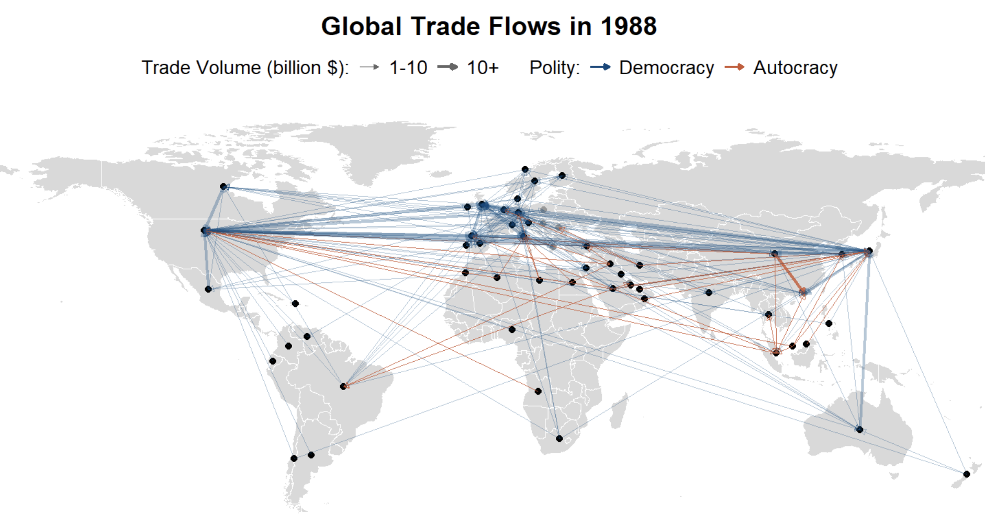
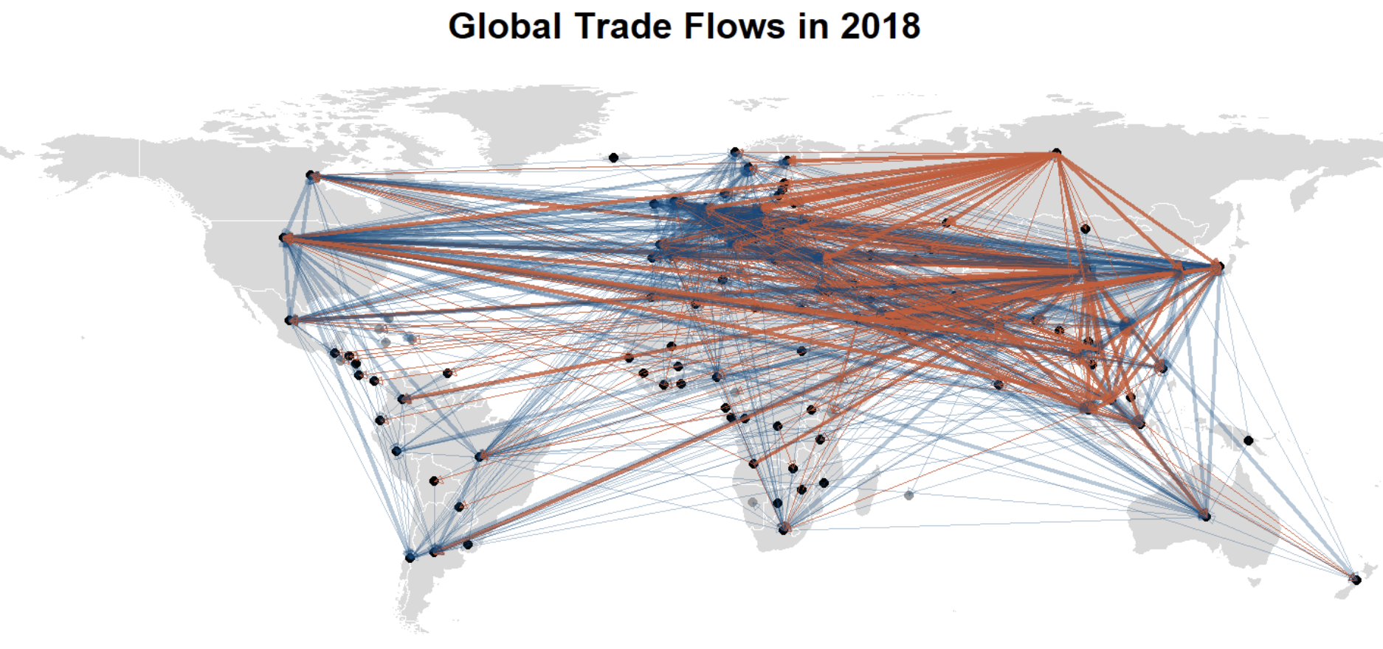
e.g. Hyper-globalization

Slide 9
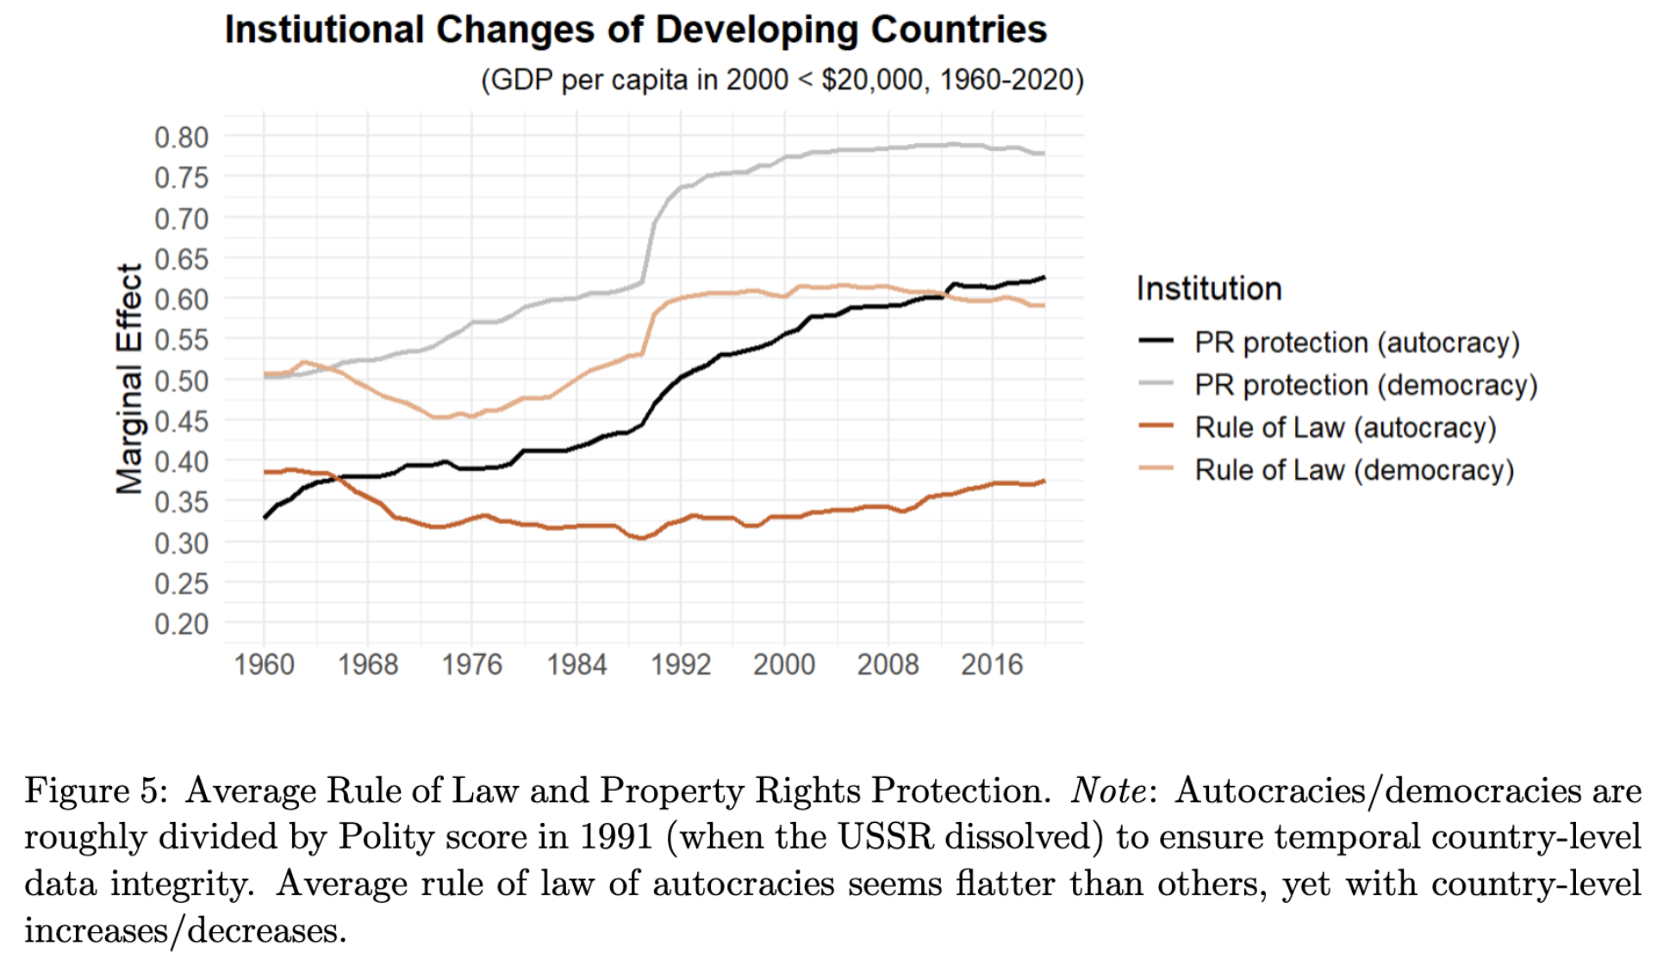
Transformation: Institutional Reform
Both autocracies and democracies
Market-oriented & institutional reform
PR protection and RoL most important (Acemoglu et al. 2005)
E.g. Turkmenistan vs. Azerbaijan

Slide 10
Why autocracies?

Slide 11
Globalization: Taking “Autocratic Adv.” Seriously
Dozens of stars in East/Southeast Asia, East Europe, and the Gulf region
Other cases (to varied degrees):
… Pinochet’s Chile (1980/90s); Franco’s Spain (1959–1974); Junta’s Brazil (1968-1973); Salazar’s Portugal (1960s); PRI’s Mexico (1980/90s); Fujimori’s Peru (1993–1999); Trujillo’s Dominican Re- public (1950/60s); Colombia (1958-1974); Argentina (1966-83); dos Santos’ Angola (2002–2008); Ben Ali’s Tunisia (1990–2010); Kagame’s Rwanda (2000–2019); Botswana (1966–1980); Zenawi’s Ethiopia (2004–2012); Obiang’s Equatorial Guinea (1996–2008); Mubarak’s Egypt (1990s–2005); Mohammad’s Morocco (1999–2008) …
Three determinants:
Reformed Institutions (PR protection, RoL …)
Expanded external markets (WTO expansion)
Active state policy (infra., indus., trade …)
Growth/Development theories:
exogenous growth (Solow 1957)
endogenous growth (Romer 1986)
institutional theory (North 1990; Acemoglu et al. 2005) developmental state (Evans 1995; Haggard 1990; Rodrik 2004)

Slide 12
Why Is Globalized Economy Different? (vs. enclosed)
Changing development logic
Local factors globally comparable and liquidatable
Earlier trade theory: comparative advantage, specialization (H-O/R-V model)
Newer trade theory: scale, firm selection, GVC/FDI (Krugman 1979; Grossman and Helpman 1991; Melitz 2003; Antras 2015) exports drive income/productivity/innovation (Atkeson & Burstein 2010; Burstein & Melitz 2013)
⇒ Shift focus outward: demand/technology/capital
Exploiting free trade
One-time gain, long-term uncertain (Garret 2000); 10% explained by comp. adv. (Osgood 2017)
Assumptions may not hold: balanced trade/exo. imbalance, no friction, effective f/x ⇒ strategic trade theory, developmental state model …
Interventions can create “artificial cost advantage” (see modes in Eaton & Kortum 2002; Arkolakis et al. 2018; Melitz 2003; Costinot et al. 2013; Epifani & Gancia 2017)
⇒ Create room for manipulative policies
Notes:
the global trade system, combined with floating exchange rates and freer capital flows

Slide 13
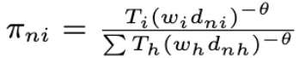
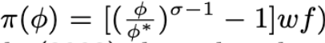
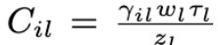
e.g. Trade Models
Eaton & Kortum 2002:
Melitz 2003:
Arkolakis et al. 2018:
Notes:
-These measures, partly because they work, were used to manage resistance, enforce compliance, and stabilize systems that prioritize market logic
-some regime characteristics that may otherwise be disadvantages in a relatively closed economy can indeed become advantageous, since the goal is about competing for external demand
-In contrast, many Latin American democracies even have stricter labor regulations than OECD countries (Feierherd 2024)

Slide 14
Autocratic Advantages in a New, Globalized Economy
Since 80/90s, neoliberal reforms often rely on (semi)authoritarian measures (Bruff 2014)
Disadvantage ⇒ advantage: inst. & non-inst. / active & passive (reformed autocracies)
Centralized power: less deliberation, respond swiftly, resist shocks, consistent planning, state support (Clegg et al. 2018; Haggard 1990; Kim 2018; Wade 1990; Wu 2016)
Weak institutional constraints: lack opposition, large win-set, divert resr. to indus, attract MNCs, manipulate policies (Allen & Ge working; Brune et al. 2001; Steinberg and Malhotra 2014; Lipscy 2018; Putnam 1995)
Lack of accountability: market/MNC-favoring policies, resist redistribution, suppress labor/env/corporatist, impose austerity/saving (Quinn and Woolley 2001; Sah 1991; Zakaria 1997; Rodrik 1999; Manger and Sattler 2015; Feierherd 2024; Krueger 1974)
Resource endowment: revenue and spending power. e.g., investing bureaus Qatar, UAE
Notes:
-These measures, partly because they work, were used to manage resistance, enforce compliance, and stabilize systems that prioritize market logic
-some regime characteristics that may otherwise be disadvantages in a relatively closed economy can indeed become advantageous, since the goal is about competing for external demand
-In contrast, many Latin American democracies even have stricter labor regulations than OECD countries (Feierherd 2024)

Slide 15
My Argument
Autocratic Institutions:
Although weak in generating internal demand due to non-inclusive political institutions
Strong in competing for external demand enabled by a globalized economy
Only “engaged reformers” – reformed and engaged by the global trade regimes (discussed later)

Slide 16
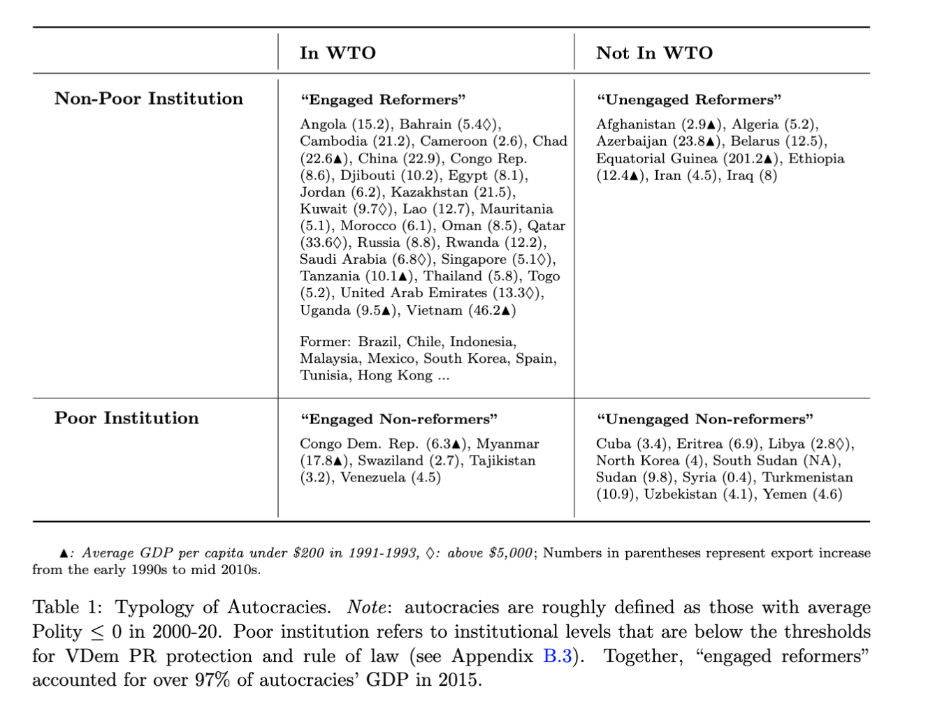
“Engaged Reformers”: Face Validation

Slide 17
Empirics

Slide 18
DV (regarding External Demand)
Exports
Gain in income/productivity/innovation (Bernard et al. 2018; Helpman and Krugman 1985)
r = 0.74 (avg. growth rate, 1992-2015)
External Balance:
Persistence indicates structural/development issues; redistribution of demand (Blanchard and Milesi-Ferretti 2009; Obstfeld and Rogoff 2009; Chinn and Ito 2021)
r = 0.65 (avg. growth rate)
Success stories: East Asia, Core Europe, Gulf states
17 of 20 highest R&D expenditure countries
* trade has spill-over effects (e.g., China shock, dependency)

Slide 19
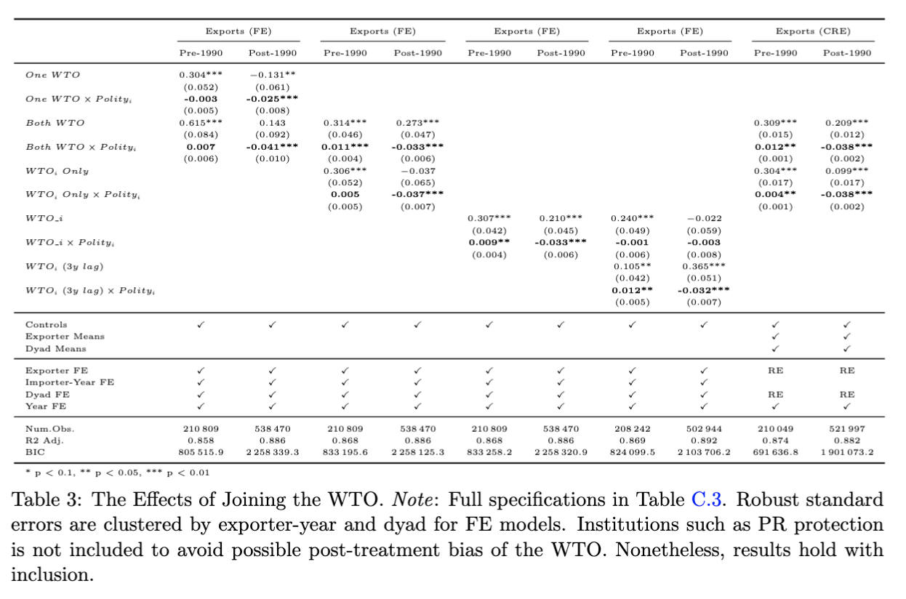
Result 1.1: WTO Accession
Gravity model:
(Anderson & van Wincoop 2003; Carnegie 2014; Goldstein et al. 2007; Rose 2004; Yu 2010 …)
CRE model:
(correlated random-effects)
Polity
-5: 45.5%
5: 4.6%
-10: 71%
10: -11.4%

Slide 20
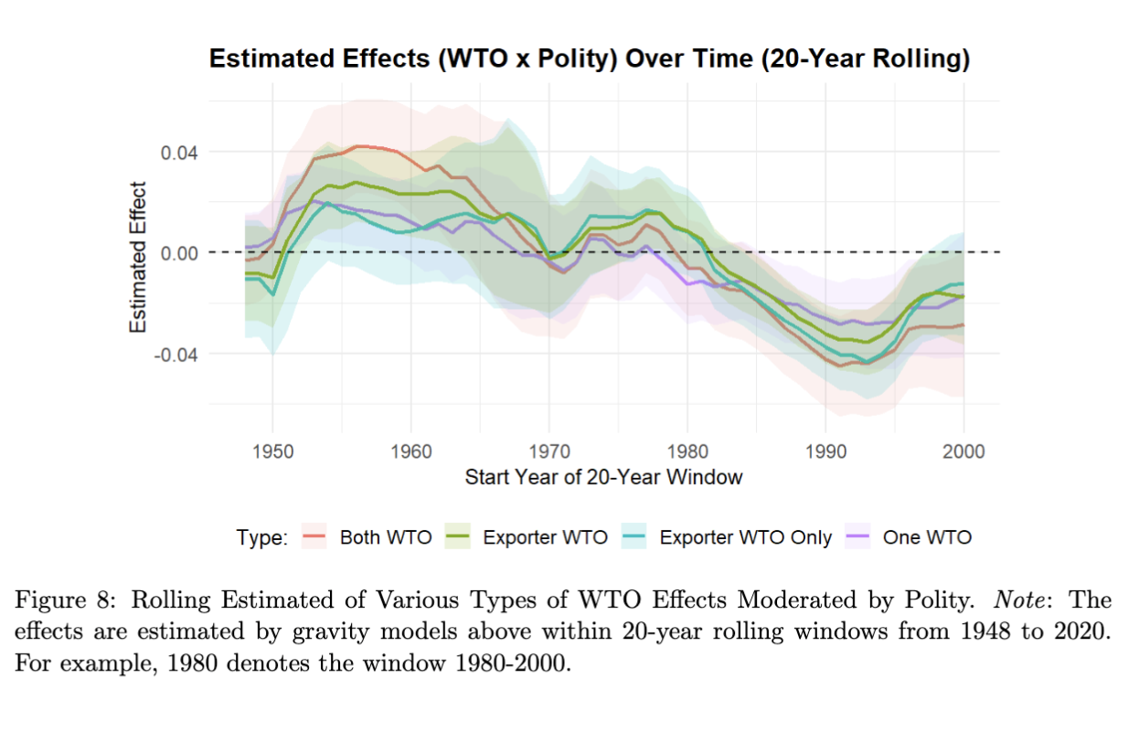
Result 1.1: WTO Accession

Slide 21
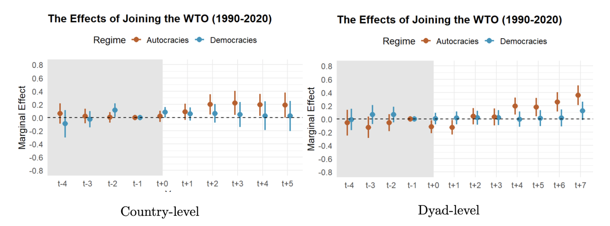
Result 1.1: WTO Accession
Sensitivity Analysis: Population (x250), GDP (x1000), Polity (x12)
DiD w/ matching:

Slide 22
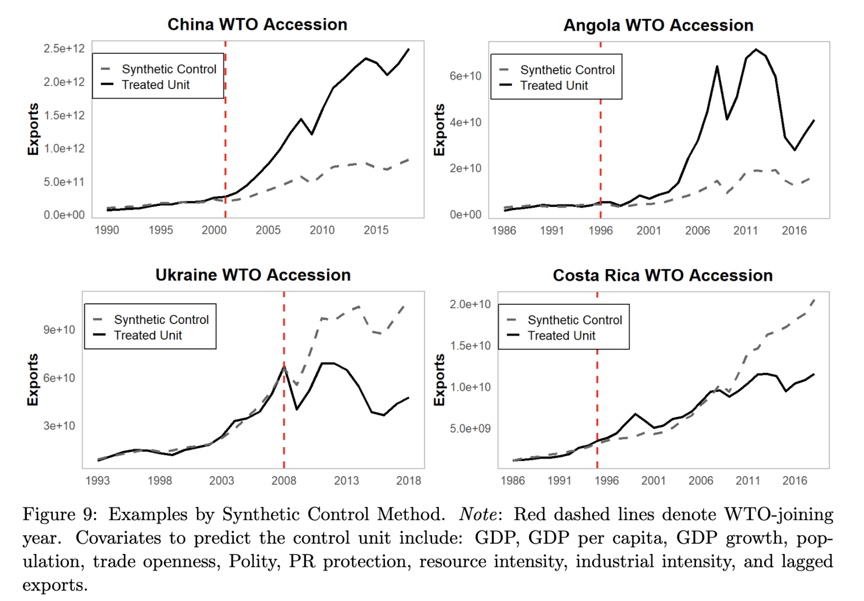
Result 1.1: WTO Accession
Examples, SCM:

Slide 23
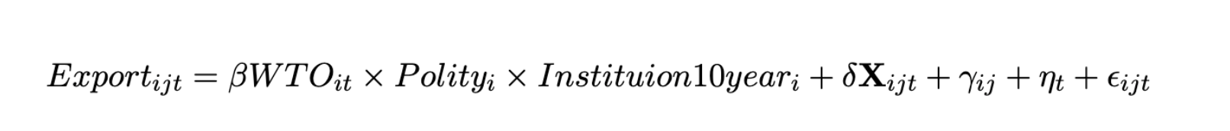
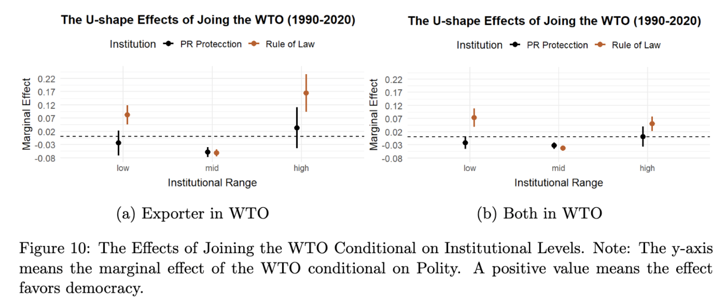
Result 1.2: Vary by Inst. (U-shape)
*inst. range dummy: lowest/highest 20th quantiles in 2000, w/ a ±10 ppt. variation.

Slide 24
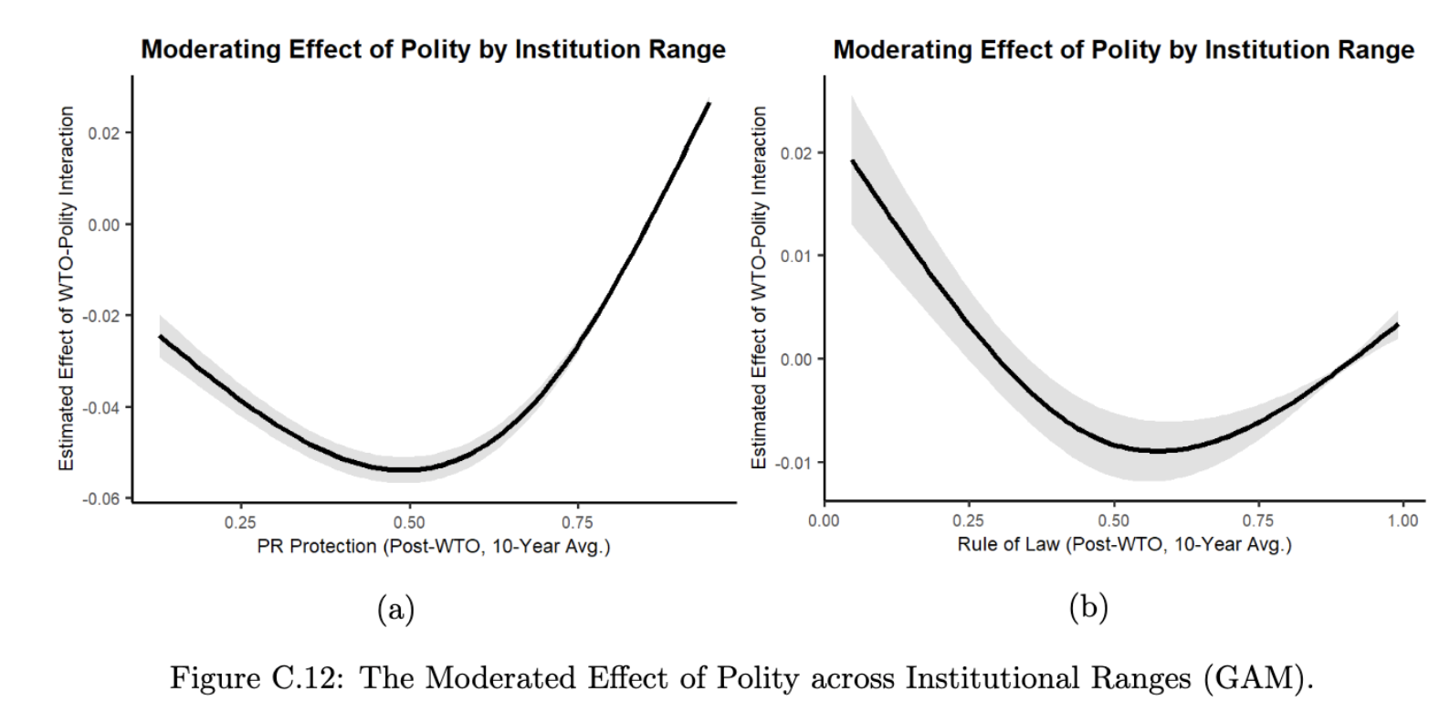
Result 1.2: by Inst.
Semi-parametric estimation (Generalized Additive Model)

Slide 25
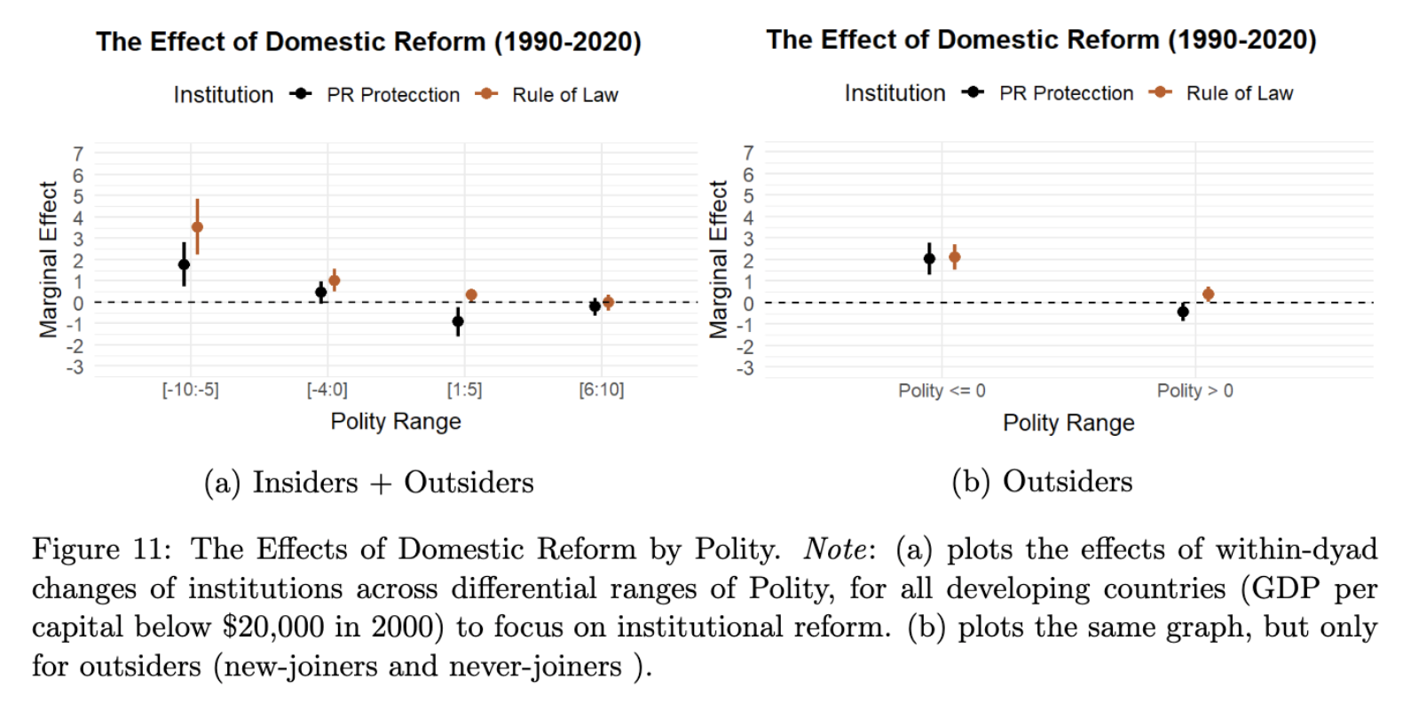
Result 2.1: Inst. Reform

Slide 26
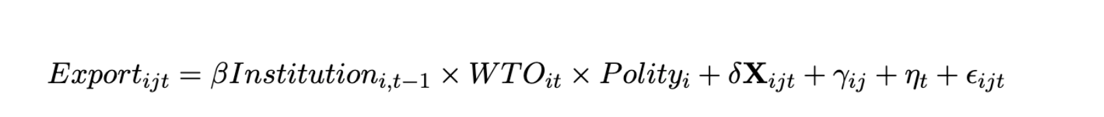
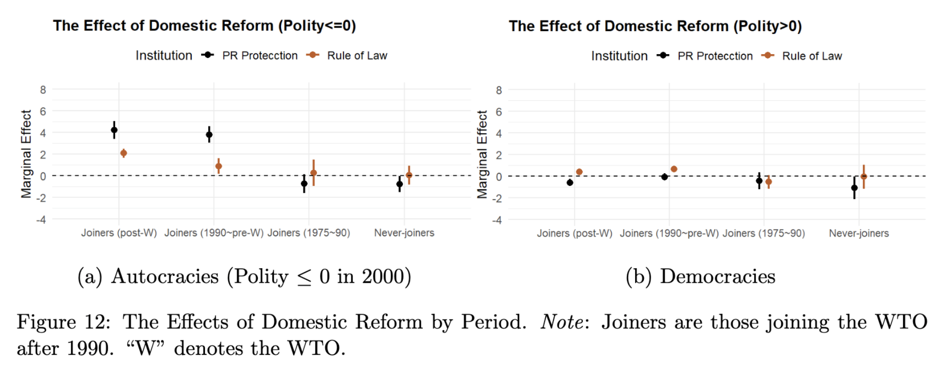
Result 2.2: Vary by WTO-related Period
Notes:
Although it’s hard to know the counterfactual of reform effect of when joiners are not in WTO, we can still get some effect

Slide 27
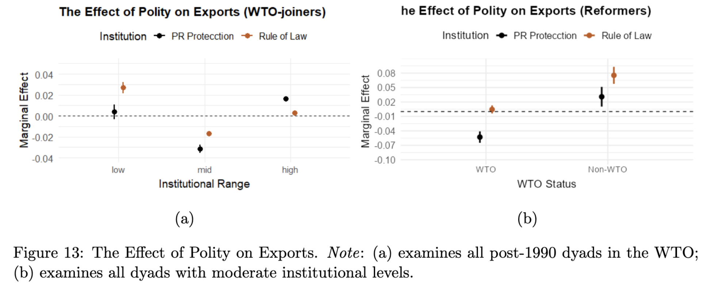
Result 3: Absolute Exports

Slide 28
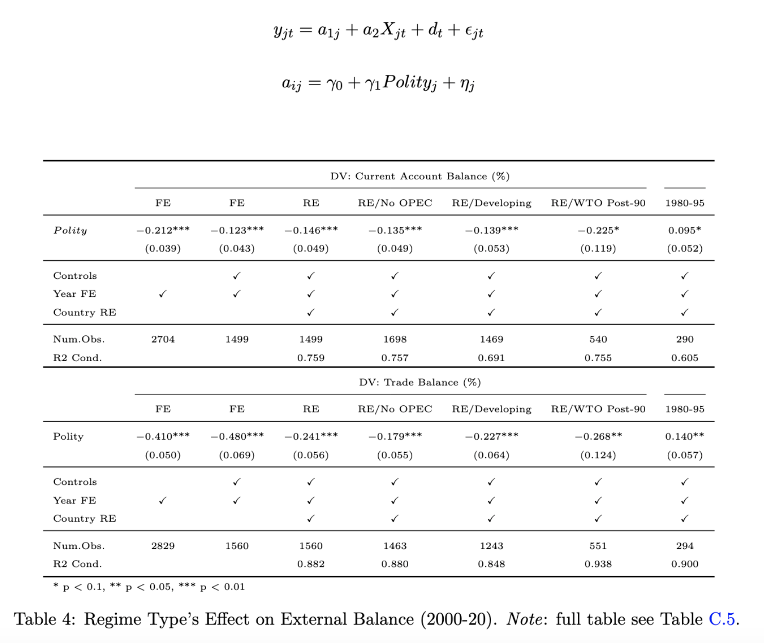
Result 4: External Balance
Hierarchical Model
(Chinn and Ito 2021; Manger and Sattler 2020)

Slide 29
Mechanisms

Slide 30
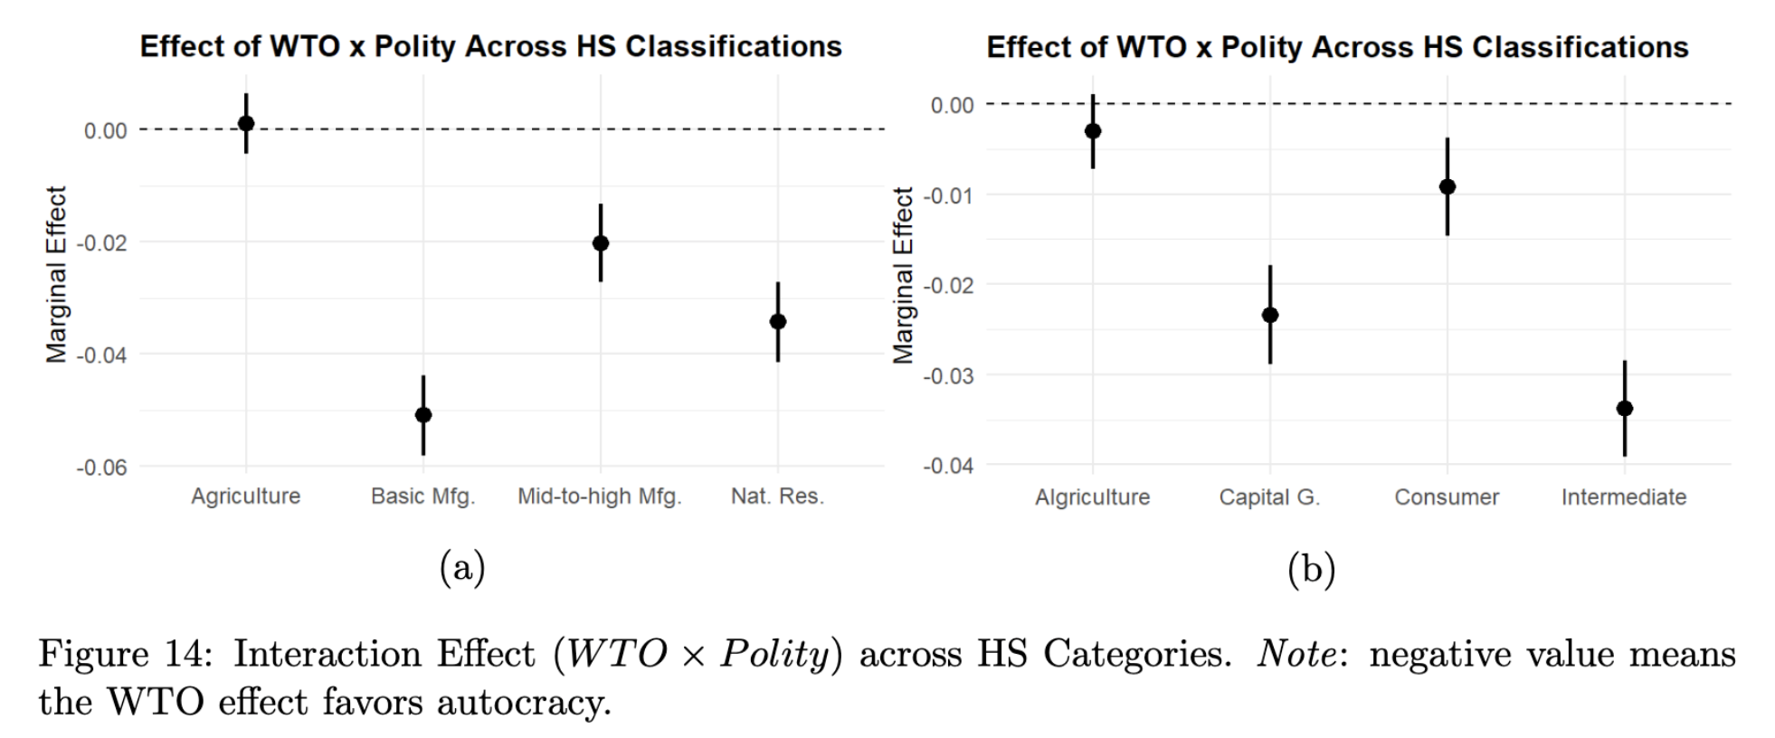
Mechanisms: Sectoral-level Evidence

Slide 31
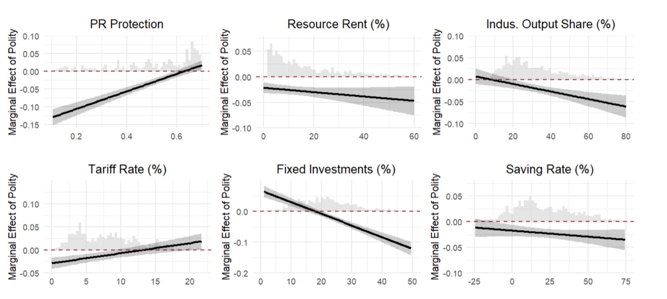
Mechanisms: Mediating Tests

Slide 32
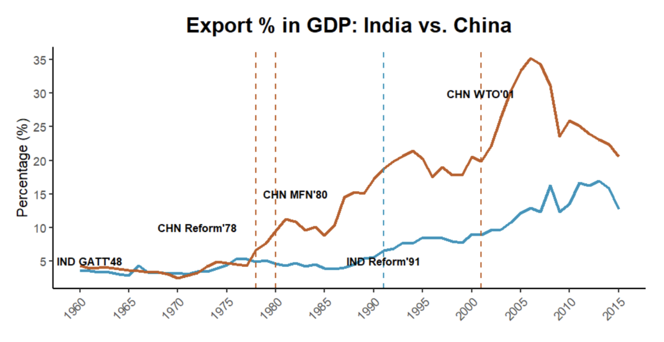
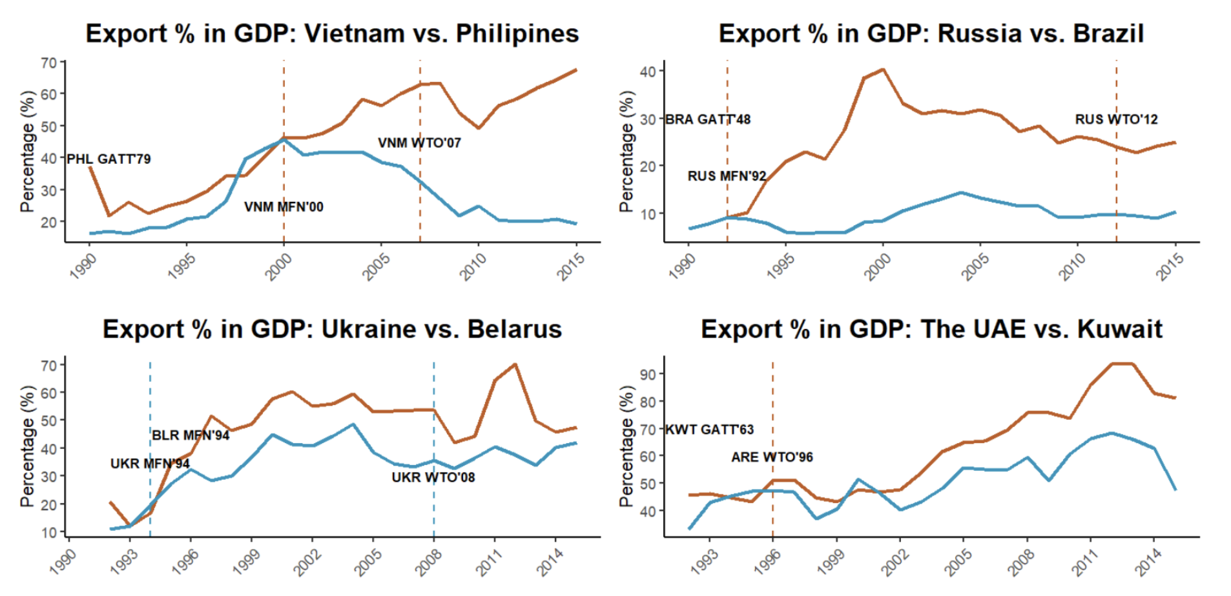
Qualitative Case Comparison
“...China’s political regime allows a gradualist approach which blended state control with market, and long-term planning employing mercantilism (e.g., economic zones and industrial policies) (Lin et al. 2003), as well as the suppression of labor wages…”
“…India’s democratic system, though more inclusive, must navigate coalition politics, public dissent, and legal constraints, resulting in slow decision-making and low mercantilist policies (Groth 2006)…”
See paper for more…

Slide 33
Possible Questions
Selection bias?
Catch-up story?
State capacity?
Democracy-autocracy trade before 1990?
Back-and-forth in GVC?
Spillover and commodity boom?
MFN status?
FDI?

Slide 34
Conclusion
Takeaways:
Autocratic success is unlikely without a globalized economy (related: democratic backsliding)
A theory for global democracy crisis ⇒ external factor (complement Acemoglu et al., Ang…)
If “Trump is the outcome” due to structural causes behind trend – get worse if causes unaddressed
Free trade/globalization is not wrong; policymakers ignored assumptions
Thank you!

